Slide 1

OpenChatLog
A Search Engine for
LLM Generated Texts
Shangqing Tu
2022210880

Slide 2
Contents
01
02
Problem Statement & Motivation
System Design
03
04
Implemented Prototype
Demo

Slide 3
01
Problem Statement & Motivation

Slide 4


Search engine vs. LLM
Can large language models (LLM) replace search engines?
VS.

Slide 5
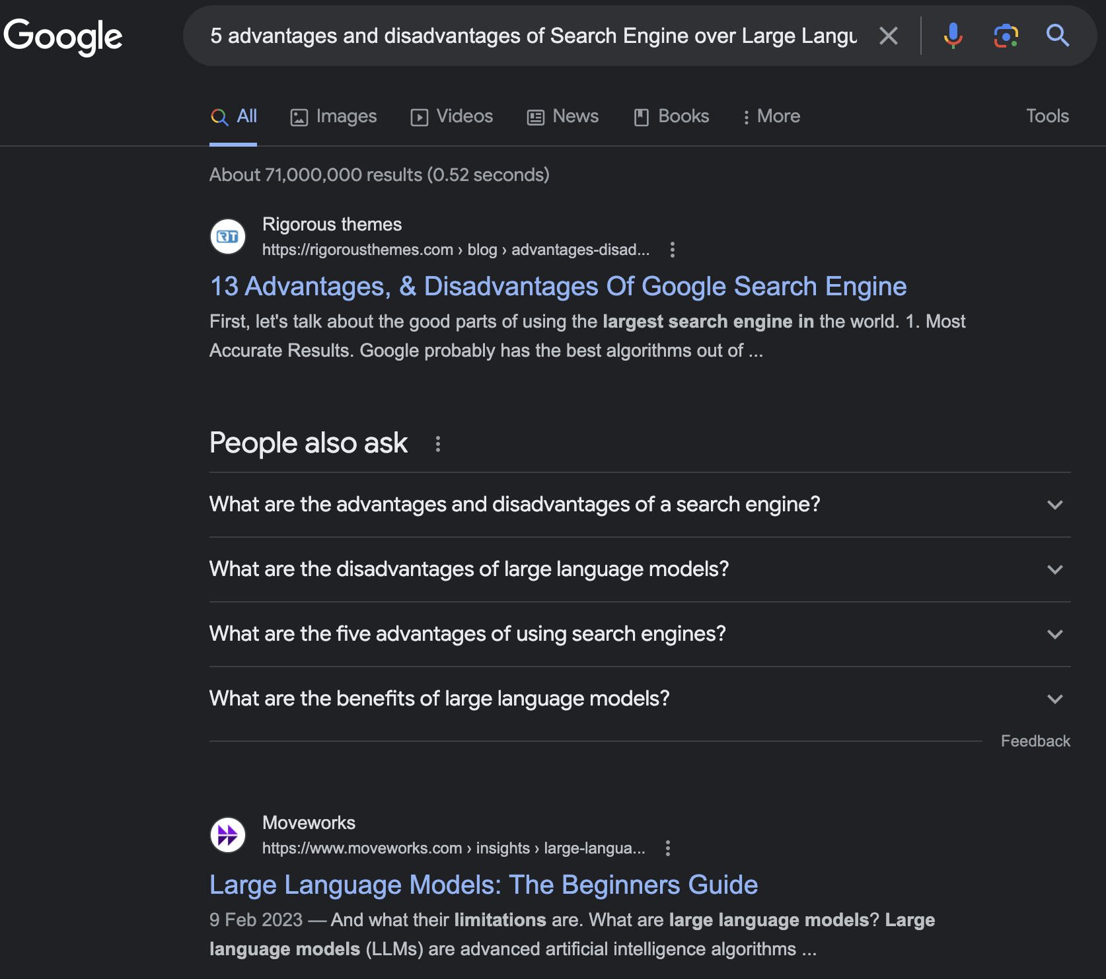
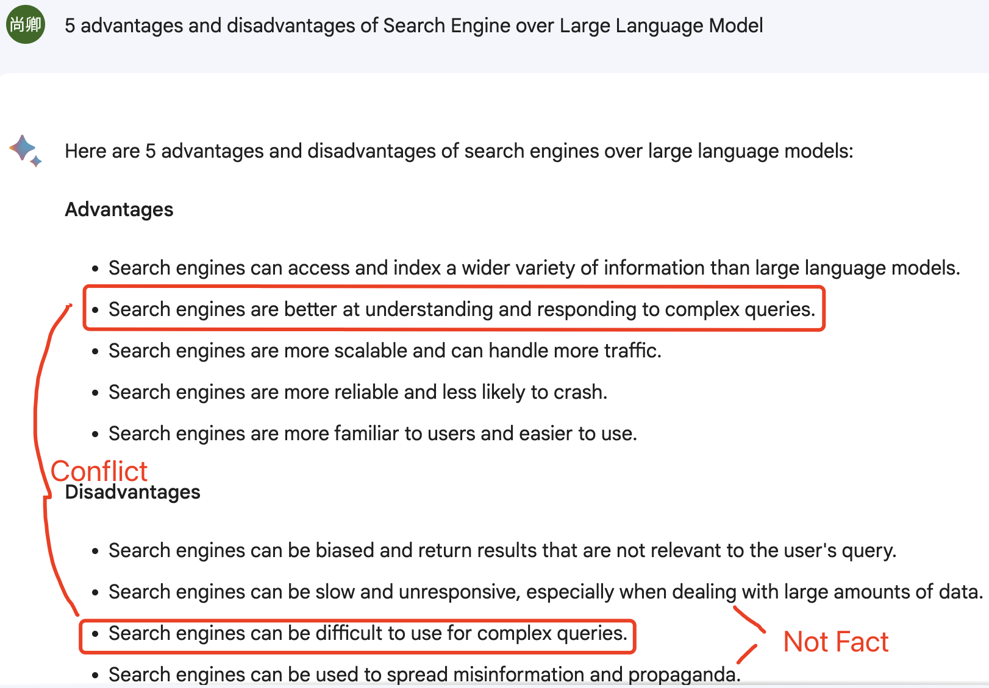
Search engine vs. LLM

Slide 6
Search engine vs. LLM
Deployment | Search engine | Large Language Model
🔧 Training Cost | ☑ Google (Use No GPU) | ❌ GPT4 (200M$)
💰 Inference Cost | ☑ Google (Ads for customers) | ❌ GPT4 ($0.03 for 1K tokens)
⏰ Time Efficiency | ☑ Google (within 1 second) | ❌ GPT4 (10-20 seconds)
Service | Search engine | Large Language Model
🪩 Response Numbers | ☑ ( 100M responses) | ❌ (1 response)
💊 Safety | ☑ (Determinate results) | ❌ (Misinformation)
📝 Creativity | ❌ (Not creative) | ☑ (creative)
Notes:
GPT-4 estimated training cost is upper bounded to $200M using 10,000 A100 X 11 months
According to Google, the average response time should be under 200 milliseconds as it gives the feeling of an instant response. A web response time ranging between 200 milliseconds and 1 second is considered acceptable as users still likely won't notice the delay.

Slide 7
Combine Search engine with LLM
Using searched up-to-date knowledge to enhance LLM
（e.g. ChatGPT Plug-in）
Using LLM response as a supplyment search result
(e.g. Google extension)
My thoughts:
Build A Search Engine for LLM Generated Texts
Notes:
Search engine and LLM are good at different things

Slide 8
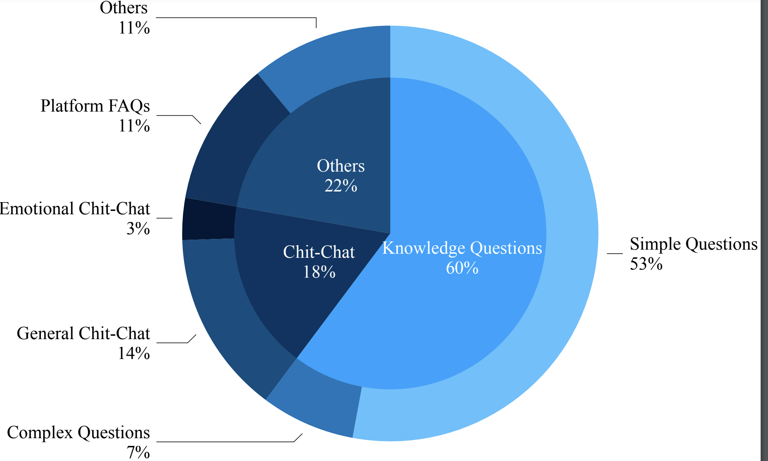
Why we need a Search Engine for LLM?
For efficiency
Some queries
can be answered
by FAQ
For exploration
Provide more
related but diverse
answers
Proportion of query types for a real Chat system [1]
[1]Song Z, Tang J, Liu T X, et al. XiaoMu: an AI-driven assistant for MOOCs[J]. Science China Information Sciences, Science China Press Beijing, 2021, 64(6): 164101.

Slide 9
02
System Design

Slide 10
Design a Search Engine for LLM
Collect Data
Data Sources
Open
API
Data Format
Build Backend
ElasticSearch
Build Front Page
UI

Slide 11
System Design: 2 Data Sources
Two Main Data Sources
Open source LLM responses corpus
Mainly from ChatGPT and GPT4
10 datasets of LLM responses from github
Api Calling
Use gpt-3.5-turbo to get data every day

Slide 12
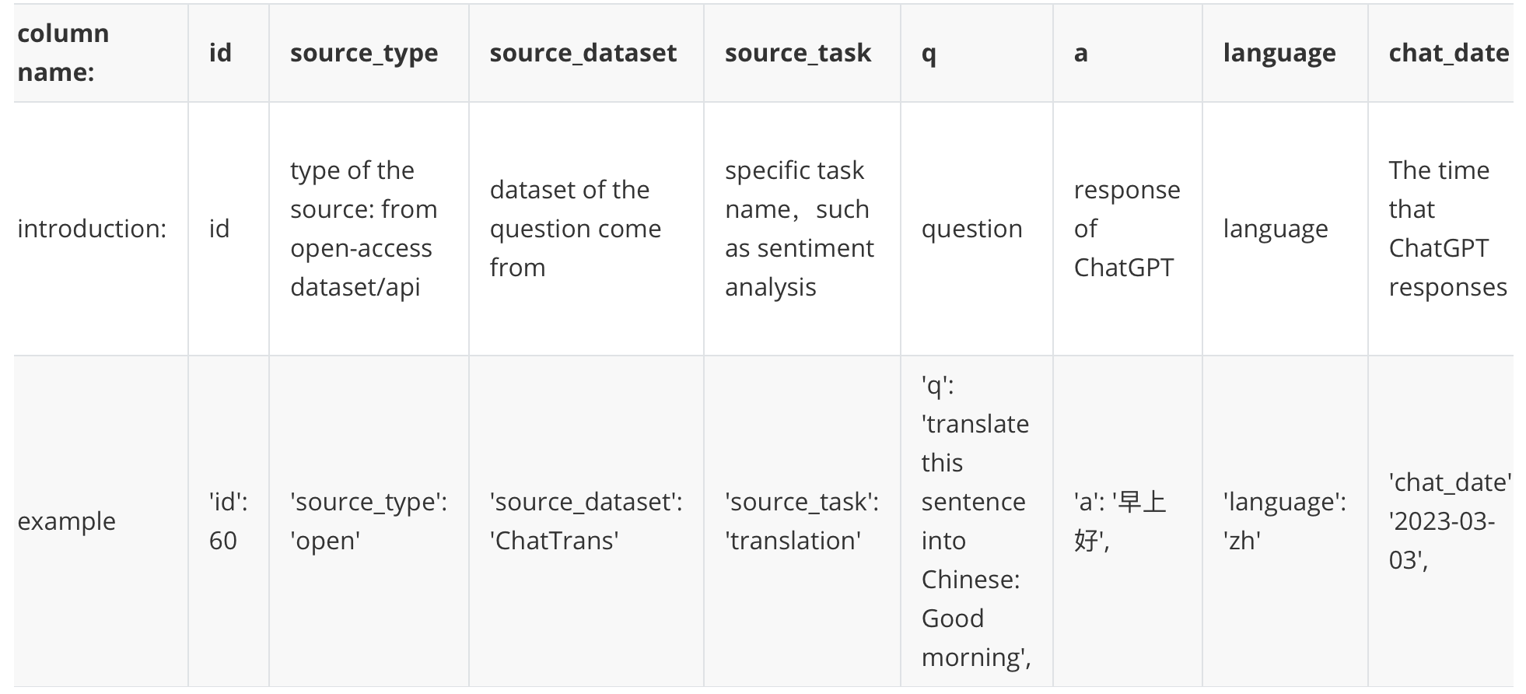
System Design: Data Format
Unify the Data Format

Slide 13

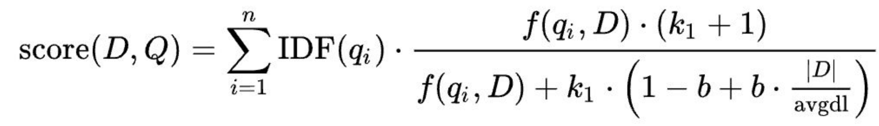
System Design: Indexing and Ranking
Pre-Processing
Filter over length and offensive texts
Indexing
Elasticsearh
Ranking
BM25

Slide 14
03
Implemented Prototype

Slide 15
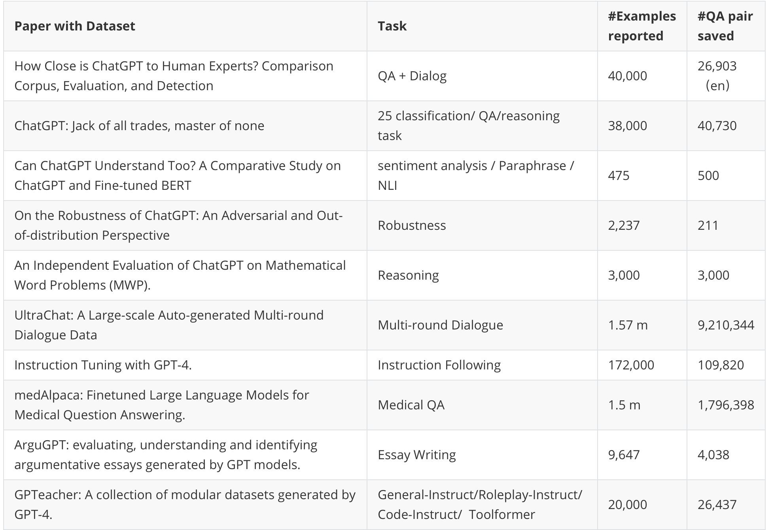
Open Data Details
10 datasets
From GitHub
Over
100,000,000
qa pairs
5GB data

Slide 16


API Data from OpenAI
Why OpenAI can not
do our job?
For Privacy Policy
OpenAI just keep
30 days chatlog

Slide 17
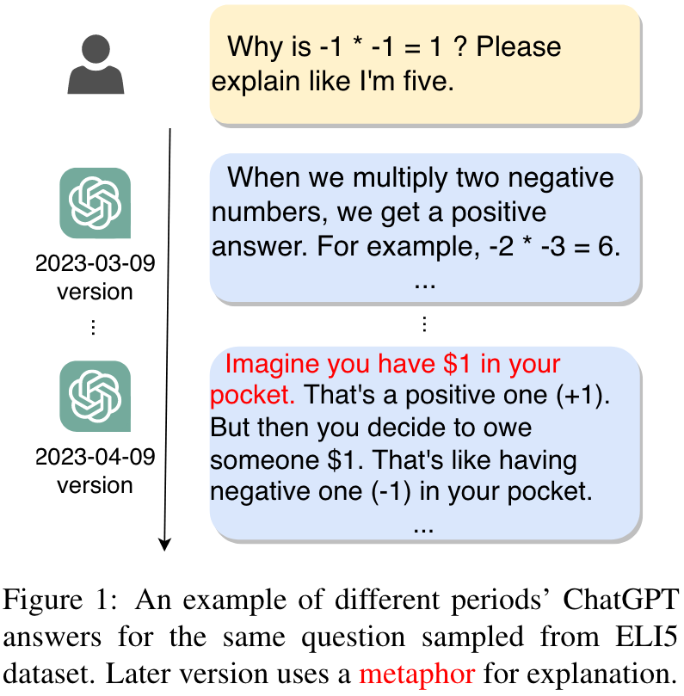
API Data from OpenAI
I collect a dataset called ChatLog[2]
ChatLog consists of two parts
that update monthly and daily:
1. ChatLog-Monthly are 38,730 QA pairs
for NLU tasks colleted from ChatGPT
every month.
2. ChatLog-Daily, consists of
ChatGPT’s responses to
1000 identical questions for
long-form generation every day.
[2] Tu S, Li C, Yu J, et al. ChatLog: Recording and Analyzing ChatGPT Across Time[J]. arXiv, 2023.

Slide 18
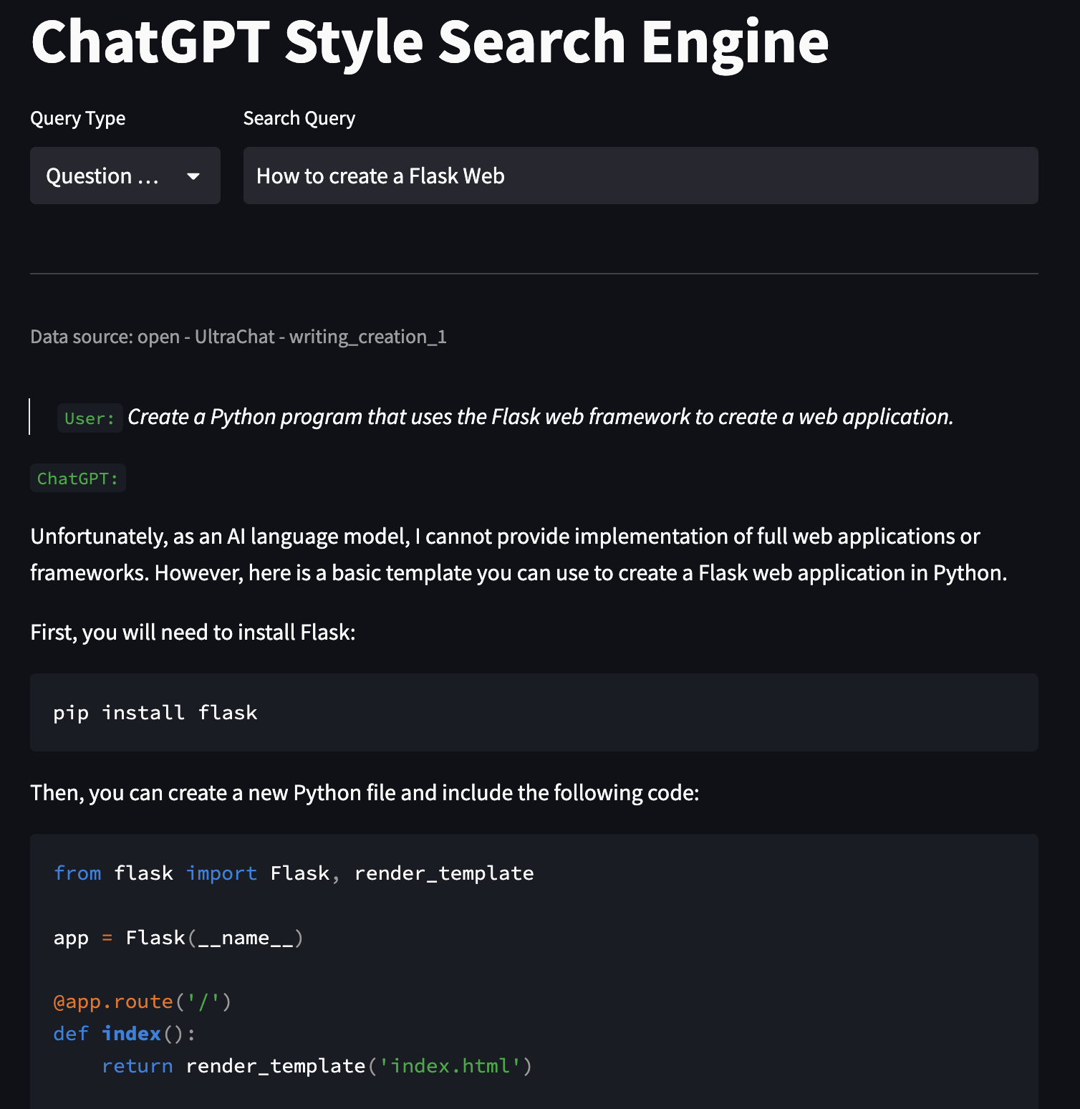
Front-End and Search UI
Search for related questions

Slide 19
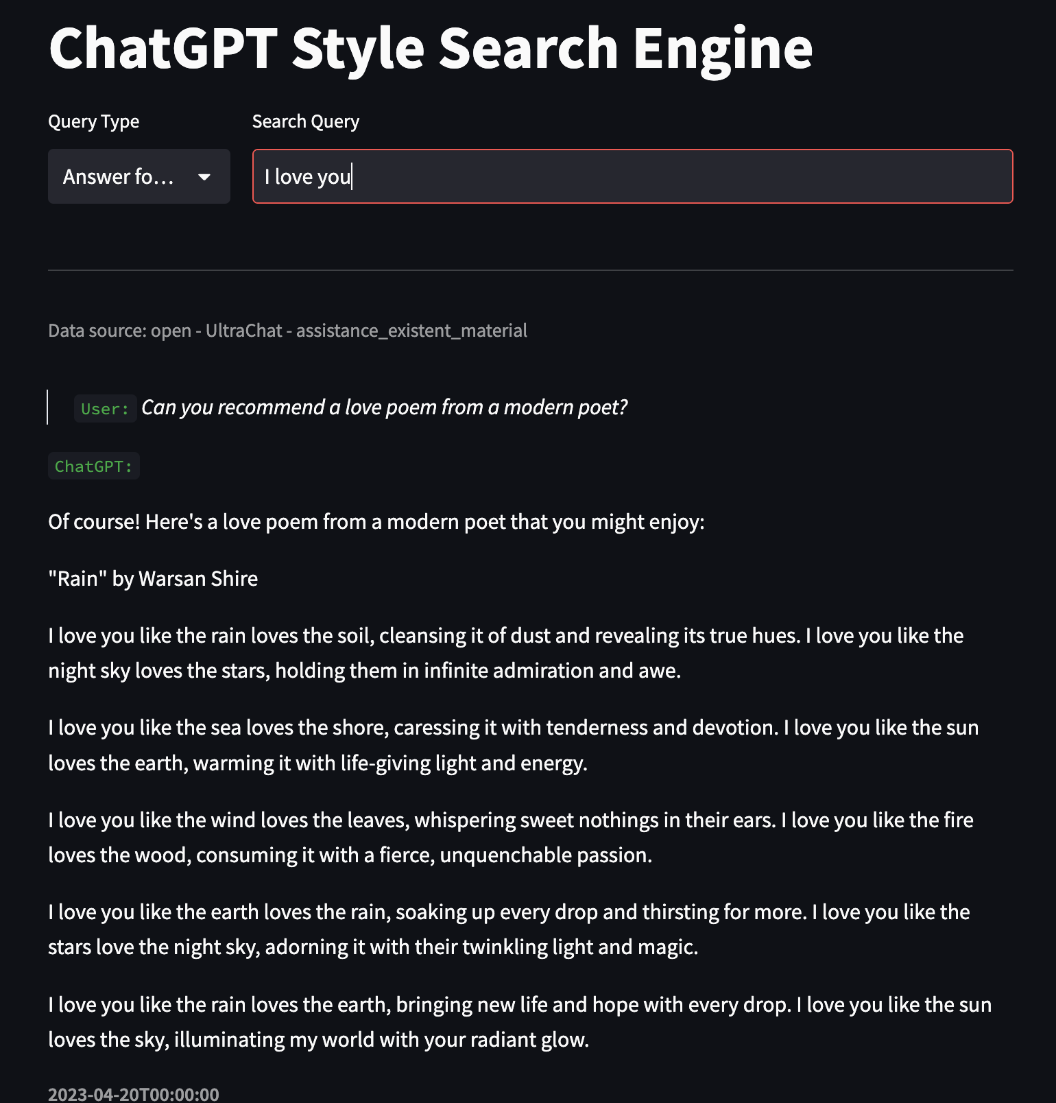
Front-End and Search UI
Search for related answers

Slide 20
04
Thanks for Listening!
Please try the Demo!

